Slide 1

a case
study
on:
boba
A CASE STUDY BY CHELSEA MAE NANASCA
GOOGLE DATA ANALYTICS, 2025

Slide 2
Table of Contents
PHASE 1: ASK
PHASE 2: PREPARE
PHASE 3: PROCESS
Main Buisiness Task:
Buisiness Task
Problems:
Problem 1
Problem 2
Problem 3
Problem 4
Guiding Questions:
Prepare: Guiding Questions 1
Prepare: Guiding Questions 3
ROCC (Guiding Questions 2)
ROCC 1
ROCC 2
ROCC 3
Key Tasks:
Prepare: Key Task
Guiding Questions:
Process: Guiding Questions 1
Key Task:
Process: Key Task

Slide 3
Table of Contents
PHASE 4: ANALYZE
Drink Information:
Top Drink Information
Drink Price Range
Cost Average for Drinks
Food Information:
Snack Price Range
Cost Average for Snacks
Rent and Startup Cost:
Rental Cost
Listing Reasoning
Startup Cost
Revenue:
Cost Per Drink
Drink Profits
Pork Gyoza Profit
Tofu Gyoza Profit
How has this Helped: .
How has this Helped my Buisiness Question?
Key Tasks:
Key Tasks for the Analyze Stage
Guiding Questions:
Guiding Questions 1
Guiding Questions 2
Guiding Questions 3
Demogrpahics in Orange:
Demographics in Orange
Race Demographics
Facts about Orange

Slide 4
Table of Contents
PHASE 5: SHARE
Evidence Five:
Retail Spaces
Listing Analysis
Evidence Four:
Startup Cost:
Technology
Drinks
Food
Hourly Pay
Yearly Profit:
Yearly Income for Drinks
Yearly Income for Pork Gyoza
Yearly Income for Tofu Gyoza
Evidence Three:
Popular Drink Flavors
Analysis of Popular Drink Flavors
Evidence Four:
Cheapest Drinks
Most Expensive Drinks
Average Drink
Cheapest Foods
Most Expensive Snacks
Average Snack
Price Analysis 1
Price Analysis 2
Evidence One:
Demographics in Orange
Race Demographics
Demographic Analysis
Evidence Two:
Boba Locations
Boba Locations: Orange
Boba Locations Santa Ana
Boba Locations: Garden Grove
Location Analysis

Slide 5
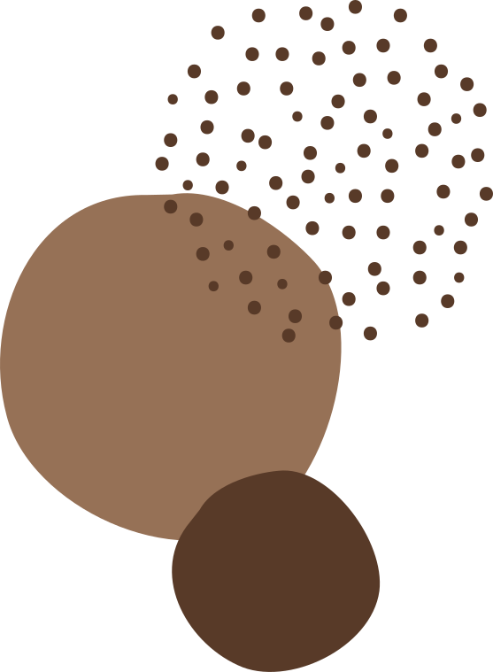

Table of Contents
PHASE 6: ACT
ENDING SLIDES
Guiding Questions:
Guiding Questions 1
Guiding Questions 2
Guiding Questions 3
Elevator Pitch:
Elevator Pitch
Works Cited:
Works Cited:

Slide 6
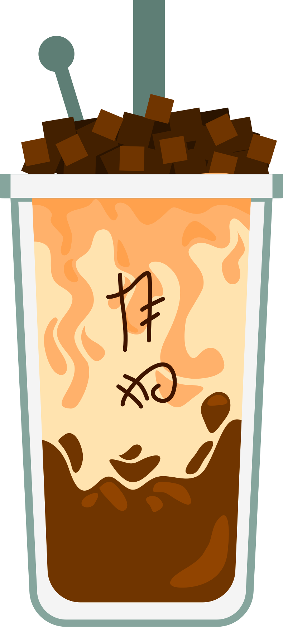
case study 4:
In the city of Orange, California: where should we open a boba shop, and how will the shop maximize profit margins?

Slide 7







Step 1: Ask

Slide 8

PROBLEM 1
problems to solve
Where are there already boba shops?
Where should our new boba shop be?
Key Stakeholders
Main investor:Johanna Shamrock
The City of Orange: 138,723 people (Data USA: Orange, California)

Slide 9
PROBLEM 2
problems to solve
What is the average existing price for boba around the City of Orange?How can we maximize profit margins for each drink?
Key Stakeholders
Main investor:Johanna Shamrock
The City of Orange: 138,723 people (Data USA: Orange, California)

Slide 10
PROBLEM 3
problems to solve
What is the best time for our cafe to be open? Would opening time influence customer activity?
Key Stakeholders
Main investor:Johanna Shamrock
The City of Orange: 138,723 people (Data USA: Orange, California)

Slide 11
PROBLEM 4
problems to solve
How much would it cost to operate this buisiness? Should we consider opening a franchised buisiness?
Key Stakeholders
Main investor:Johanna Shamrock
The City of Orange: 138,723 people (Data USA: Orange, California)

Slide 12
Step 2: Prepare

Slide 13
WHERE IS YOUR DATA LOCATED?
guiding questions: 1
All of my data is organized on this Google Sheet
IS YOUR DATA IN LONG OR WIDE FORMAT?
The data is organized in the wide format the google spreadsheet above.
Prepare: Questions on my data collection process
BIAS/CREDIBILITY ISSUES?
There are issues with credibility, as much of the data is sourced from Yelp.

Slide 14
RELIABLE?
guiding questions: 2
My data is Reliable, because I used the most popular reviews and data from cafe menus.
ORIGINAL?
My data is Original, because prices are reported on Yelp. Some restaurants provided websites with complete pricing information.
Is your data ROCC?

Slide 15
COMPREHENSIVE?
guiding questions: 2
My data is not Comprehensive, as I am unable to get boba for every boba shop. But I have data from 30 boba shops in Orange, Santa Ana, and Garden Grove.
CURRENT?
Is your data ROCC?
This data is Current, as I only chose information from non seasonal drink items, and checked current Yelp input from menus. All data collected was collected between: April 20th - April 24th, 2025.

Slide 16
guiding questions: 2
CITED?
All of the data that is collected is public on the website Yelp. All of the reviews are public as welll.
Is your data ROCC?

Slide 17
HOW ARE YOU ADDRESSING LICENSING, PRIVACY, SECURITY, AND ACCESSIBILITY?
guiding questions: 3
I am addressing licensing privacy issues by only using public resources such as Yelp and websites that buisinesses have created.
Licensing, Privacy, and Integrity Concerns
HOW DID YOU VERIFY DATA INTEGRITY?
I am verifying data integrity by cross checking menus on buisiness websites, reading reviews that customers have made, and calling buisinesses.

Slide 18
key tasks
DATA SOURCES
USED
DATA ORGANIZATION
CREDIBILITY
The data is organized in a wide data format.
My data is mostly credible
My data is public on Yelp.

Slide 19
Step 3: Process

Slide 20

guiding questions
HAVE YOU DOCUMENTED YOUR CLEANING PROCESS TO BE SHARED?
WHAT TOOLS ARE YOU USING AND WHY?
WHAT STEPS HAVE YOU TAKEN TO ENSURE THAT YOUR DATA IS CLEAN?
I am using the prorgamming language R for data visualization. Specifically, I am using the application Rstudio cloud.
Yes! I have documented my entire data cleaning and analysis process in my changelog. This should be in my Github documentation!
I have ensured that my data is clean by removing excess spaces, by writing each variable in camelcase, and only collecting data from the city of Orange and cities bordering the City of Orange (Garden Grove, Santa Ana)

Slide 21
CHECK THE DATA FOR ERRORS:
I have checked the data for errors by cross checking available data, confirming popular drinks, and checking incorrect information.
Key Tasks
CHOOSE YOUR TOOLS:
In my data analysis process I have used: Google Sheets and R for documenting and processing data.
DATA SOURCES USED:
I used Yelp public databases with buisiness information for my data.

Slide 22
Step 4: Analyze

Slide 23
guiding questions 1
HOW SHOULD YOU ORGANIZE YOUR DATA TO PERFORM ANALYSIS ON IT?
HAS YOUR DATA BEEN PROPERLY FORMATTED?
WHAT SURPRISES DID YOU DISCOVER IN YOUR DATA?
All of my variables are organized using camelcase principles, to make it easier for the programming language R to process.
Our data is properly formatted, because each of the data types are suited to the type of data used in the presentation.
In my data, I personally found it most surprising that the top flavors were fruit flavors.

Slide 24
guiding questions 2
WHAT IS THE TARGET MARKET OF YOUR BOBA SHOP?
The target market for boba restaurants are more likely towards younger people. Due to the high concentration of college students and the appeal of places like Uptown Orange and Old Town Orange, this boba restaurant should appeal more towards Generation Y, considering that the average age is 36.9.
This makes sense as younger audiences are more likely to try new drink flavors. Appealing to students would also be beneficial considering that schools like Santiago Canyon College and Chapman University are in the area.

Slide 25





Population: 139,911
Median Age: 36.9 Years Old)
demographics
in Orange
9.15% decrease
in people living in poverty
Guiding Questions 2, Evidence 1
38.9
$96,605
Have a bachelor’s degree or higher
Median Household Income in 2023
Info from: City of Orange, Data USA

Slide 26

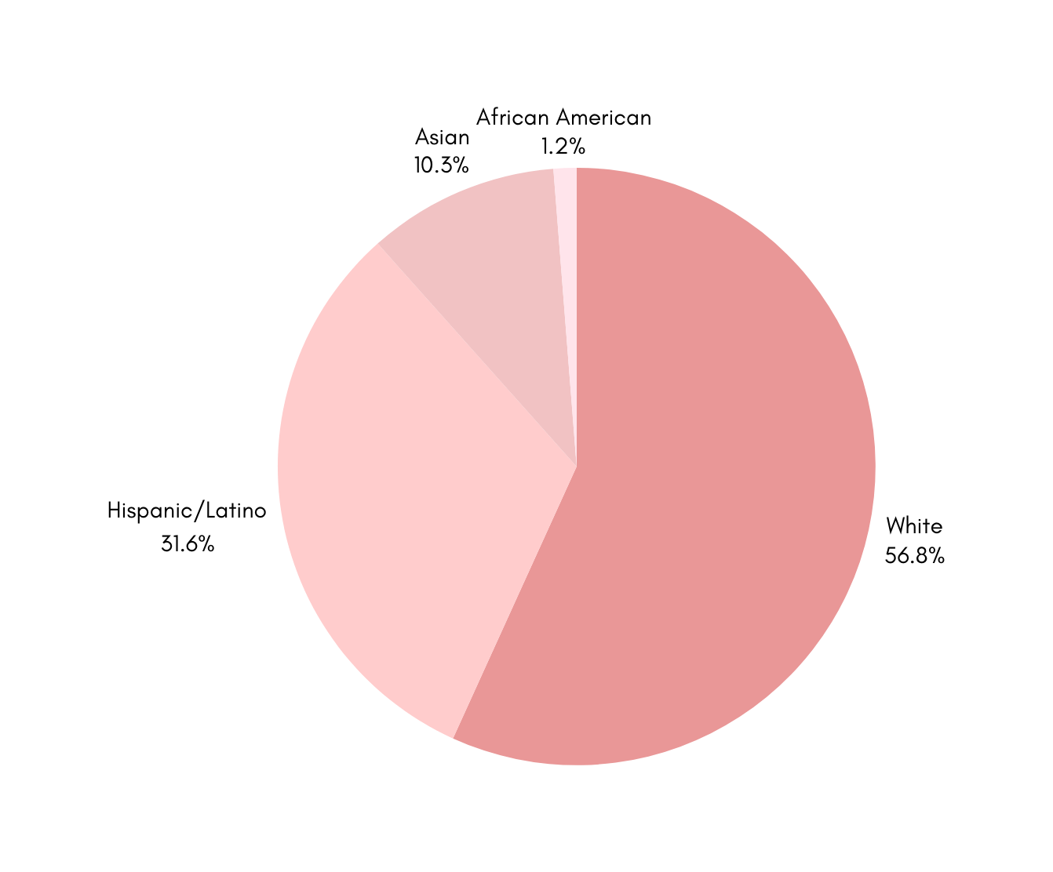


race/ethnicity demographics
Guiding Questions 2, Evidence 1
Chart made through Canva
Info from: City of Orange, Data USA

Slide 27
more about
Orange
Guiding Questions 2
Health Corridor in Orange
Old Towne Orange
Uptown Orange
Children’s Hospital of Orange County (CHOC), St. Joseph’s Hospital of Orange, UC Irvine Medical Center
Chapman, Orange City Hall, Orange Public Library
Most popular for film and television production.
The Block of Orange, The Village at Orange Mall, UC Irvine Medical Center
Have a Bachelor’s Degree
Info from: Data USA, Visit California

Slide 28
guiding questions 3
HOW MANY BOBA SHOPS ARE IN YOUR CITY? IN NEARBY CITIES?
WHAT TRENDS OR RELATIONSHIPS DID YOU FIND IN YOUR DATA?
Within the data, I found that there was a generally narrow price range for the boba and the drinks with a ~$2 dollar difference between the most expensive and least expensive goods.
In the Cities of Orange, Santa Ana, and Garden Grove, I have analyzed a total of 30 Boba Restaurants. In total, there were at least 11 Boba Restaurants in Orange, but to even the data, I made sure to also analyze 10 boba shops from each city.
In total, each city had about 10 boba shops on average.

Slide 29

1st: Milk Tea
5 MOST POPULAR DRINKS
Listed as a top flavor in 14 restaurants
2nd Place: Thai Tea
Listed as a top flavor in 11 restaurants
3rd Place: Peach
Listed as a top flavor in 9 restaurants
Guiding Questions 4
4th Place: Mango +Strawberry
Calculated based off of the top five boba flavor profiles in all of the 30 restaurants analyzed.
Tied with listings in 8 restaurants
5th Place: Jasmine
Listed as a top flavor in 7 restaurants
Info from: Google Sheet + Yelp

Slide 30
COST AVERAGES FOR DRINKS
On average the cheapest drink was
On average the most expensive drink was
$5.12
$7.24

Slide 31
COST AVERAGES FOR DRINKS
The average drink cost in the cities of Orange, Garden Grove, and Santa Ana is:
$6.18

Slide 32
COST AVERAGES FOR SNACKS
On average the cheapest snack was
On average the most expensive snack was
$3.58
$7.53

Slide 33
COST AVERAGES FOR SNACKS
The average snack cost in the cities of Orange, Garden Grove, and Santa Ana is:
$5.56

Slide 34
What does it cost to rent in your assigned city?
While I was researching retail listings in the City of Orange, I found a strip mall at the location:
Briardale Plaza 1762-1776 N Tustin St
This listing is 1,800 SF, and is $36.00 per square feet, per year.
$64,800 yearly
cost of rent
in Orange
Guiding Questions 5
Info from: Loopnet: Briardale Plaza (2025)

Slide 35
Why this listing?
In comparison to other listings on the retail space website LoopNet, this listing was relatively small and has a nearby traffic count of 39,222
What’s Nearby?
Chapman University (8 Minutes Away)
Orange High School and Richland High School (6 Min)
Lilly Hair & Nails
cost of rent
in Orange
Guiding Questions 5
Info from: Loopnet: Briardale Plaza (2025)

Slide 36


start up costs
Guiding Questions 5
startup cost: $270,681.54
This is assuming that we will sell 30 boba flavors and purchase all of the equiptment early. This is how much it would cost for the first year, including rent.
I also advise against selling food in the first year to minimize production costs. This could be introduced later.
Have a Bachelor’s Degree

Slide 37
Necessary Equiptment for Boba Restaurant: Individual Drinks
16 oz Milk Tea
50g of Bubble Tea Powder/16ox Drink: $0.42
75g of Tapioca Pearls
3g of Green Tea Leaves $0.03
Custom Logo Cup $0.04
Seal: $0.01
Plastic Straw: 0.01
start up costs
in Orange
Guiding Questions 5
Total: $0.65 Per Drink
Info from: Bubbleteaology: How much does it cost to Make Boba

Slide 38
start up costs
Guiding Questions 5
cost: $6.00
Considering the cost of production ($0.65) and the average drink prices around the area, each drink should be about this price on average. This should leave a:
Have a Bachelor’s Degree
$5.35 profit per drink
Info from: Bubbleteaology: How much does it cost to Make Boba

Slide 39
start up costs
Guiding Questions 5
cost: $5.85
According to the website I bought gyoza from, the cost for each gyoza is $0.48, and if I were to sell four gyoza each time (costing me $2.61 with the box) I would get a profit margin of:
Have a Bachelor’s Degree
$3.24 profit for pork gyoza
Info from: Webrestauraunt Store: Passport Cuisine Pork Gyoza

Slide 40
start up costs
Guiding Questions 5
cost: $5.85
According to the website I bought gyoza from, the cost for each gyoza is $0.32 and if I were to sell four gyoza each time (costing me $1.49 with the box) I would get a profit margin of:
Have a Bachelor’s Degree
$4.36 profit for tofu gyoza
Info from: Webrestauraunt Store: Chef One Vegetable and Tofu Gyoza

Slide 41
yearly revenue
Guiding Questions 5
$288,036.20
According to this estimation of sales for boba, tofu gyoza, and pork gyoza, we should be able to get the amount above after one year. We should be able to break even in:
Have a Bachelor’s Degree
about one year!

Slide 42
how has this helped answer my buisiness question?
Guiding Questions 5
This has helped answer my buisiness decisions by helping me understand what is the best way to maximize the profit margins while minimizing additional expenses.
Have a Bachelor’s Degree

Slide 43
key tasks
AGGREGATE YOUR DATA
TRENDS
RELATIONSHIP
The data is aggregated on the Google Sheets.
Overall, the trends are that the data is generally narrow.
My data is public on Yelp.

Slide 44
Step 5: Share

Slide 45
Evidence
One
Display charts of your city’s demographics.
Have a Bachelor’s Degree

Slide 46
Population: 139,911
Median Age: 36.9 Years Old)
demographics
in Orange
9.15% decrease
in people living in poverty
Guiding Questions 2, Evidence 1
38.9
$96,605
Have a bachelor’s degree or higher
Median Household Income in 2023
Info from: City of Orange, Data USA

Slide 47

race/ethnicity demographics
Evidence 1
Chart made through Canva
Info from: City of Orange, Data USA

Slide 48
demographics in
Orange
Guiding Questions 2, Evidence 1
The City of Orange offers a promising target audience with a younger average age. Though having a majority white population may be less promising in regards to initial boba sales, having the opportunity to expand boba to a wider, younger audience may be promising.
This city is also a promising area to target, as the population is generally wealthy and may be more open to buying new drinks.
Have a Bachelor’s Degree

Slide 49
Evidence
Two
How many boba shops are in your city?

Slide 50
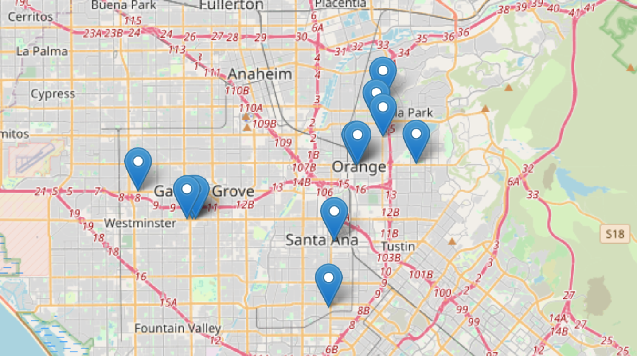

boba locations: all cities
Evidence 2
Chart made through R, using data from my Google Sheet.

Slide 51
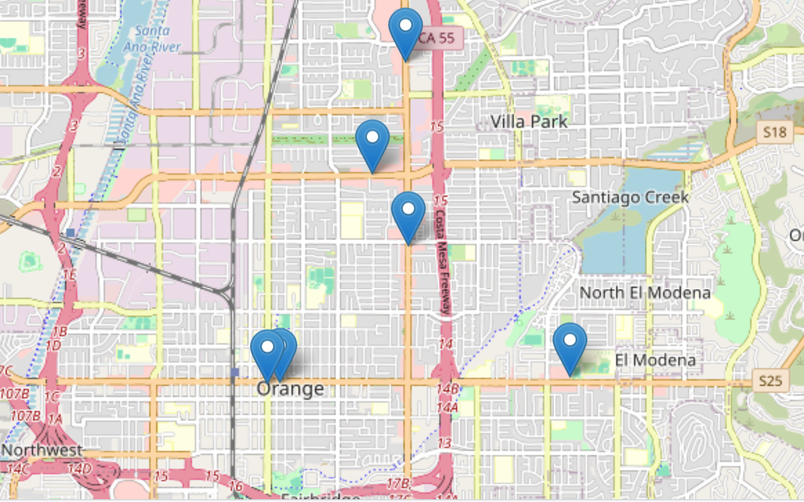
boba locations: Orange
Evidence 2
Chart made through R, using data from my Google Sheet.

Slide 52
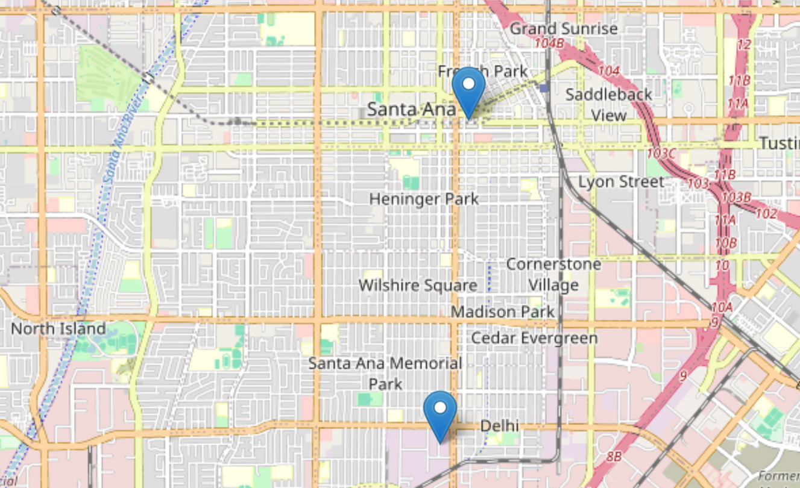
boba locations: Santa Ana
Evidence 2
Chart made through R, using data from my Google Sheet.

Slide 53
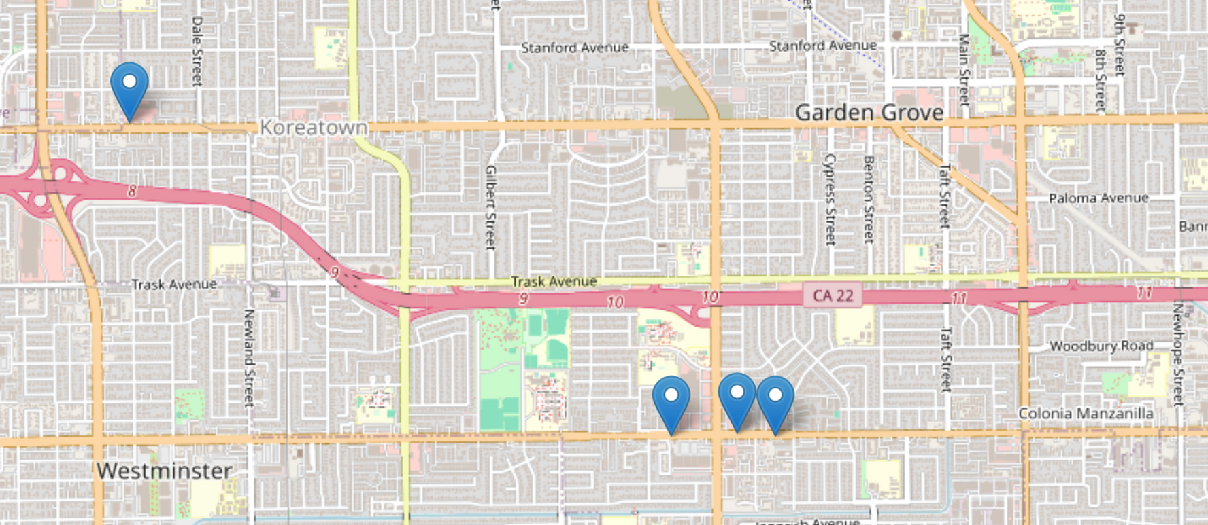
boba locations: Garden Grove
Evidence 2
Chart made through R, using data from my google sheet.

Slide 54
locations
Guiding Questions 2, Evidence 3
This data visualization shows the range of boba restaurant locations in the cities of Orange, Santa Ana, and Garden Grove. This gives insight into areas where boba is in most demand, and also places with high customer traffic.
Have a Bachelor’s Degree

Slide 55
Evidence
Three
Display charts of the most popular drinks/foods
Have a Bachelor’s Degree

Slide 56
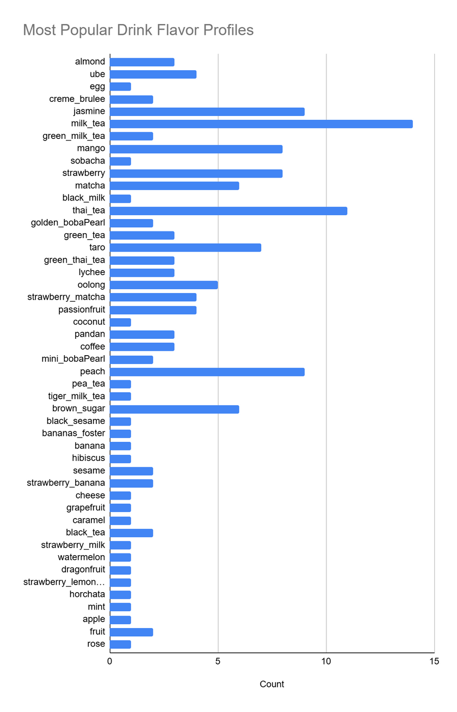
popular drink flavors
Evidence 3
Chart made through Google Sheets, using data from my Google Sheet.
This data visualization shows all of the major flavor profiles that I have found in the google sheet.

Slide 57
beverages
Guiding Questions 2, Evidence 3
A majority of the cafes analyzed have specialized beverages as a popular drink. My data is only displaying the most common flavors used!
To make a successful boba buisiness, one should consider having specialized beverage and combinations of popular flavors (e.g. ube thai tea, or strawberry matcha)
Have a Bachelor’s Degree

Slide 58
Evidence
Four
What are the prices charged for these drinks/foods? What is the average?
Have a Bachelor’s Degree

Slide 59
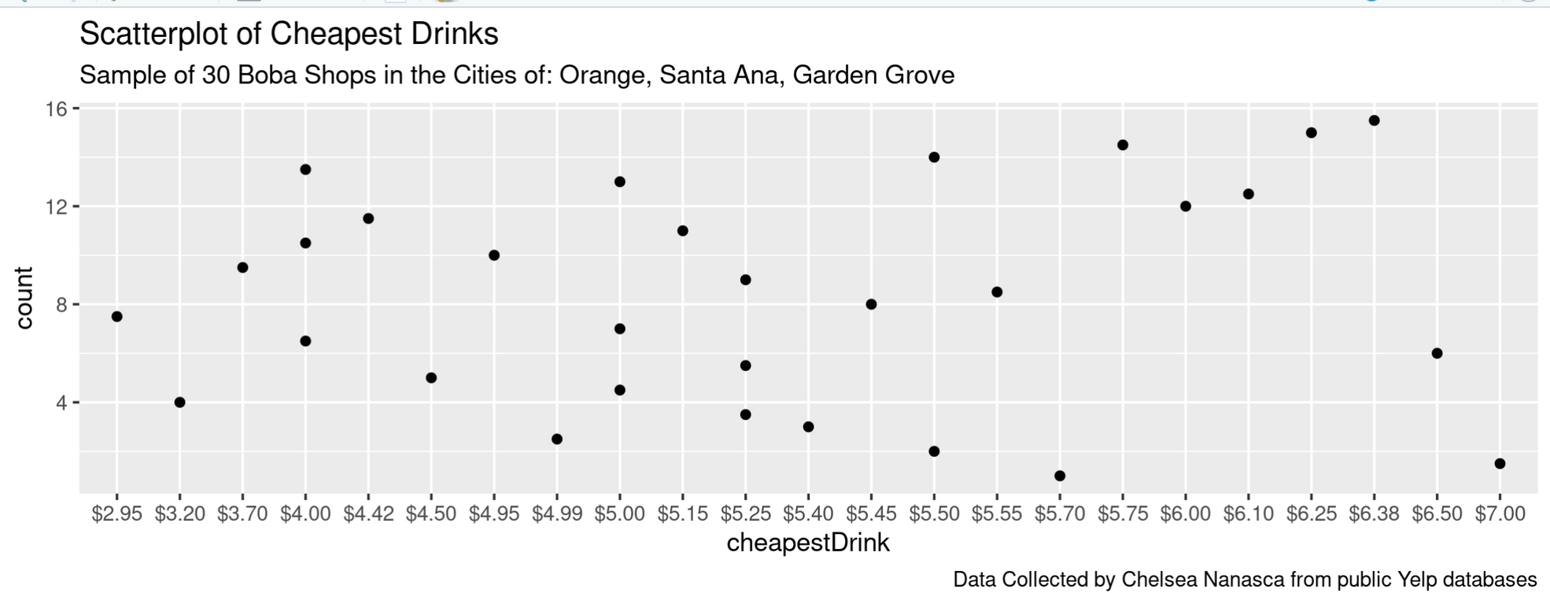
price range for cheapest drinks
Evidence 4
This scatterplot was generated using R-studio, and displays the range of cheapest beverages.

Slide 60

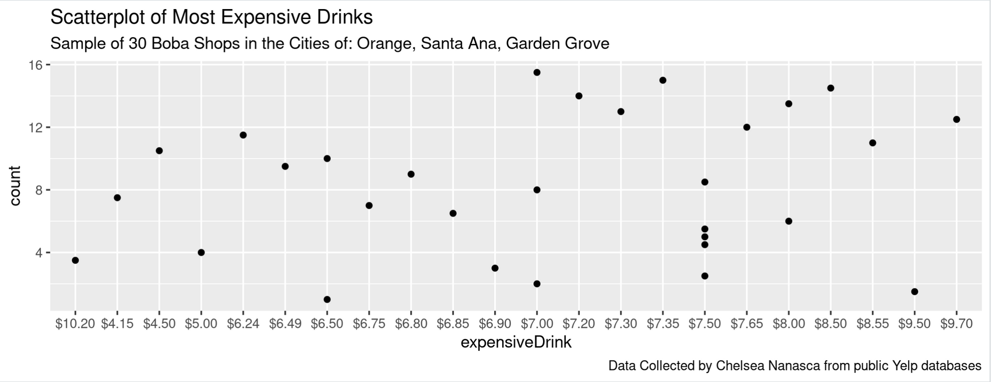
price range for expensive drinks
Evidence 4
This scatterplot was generated using R-studio, and displays the range of expensive beverages.

Slide 61
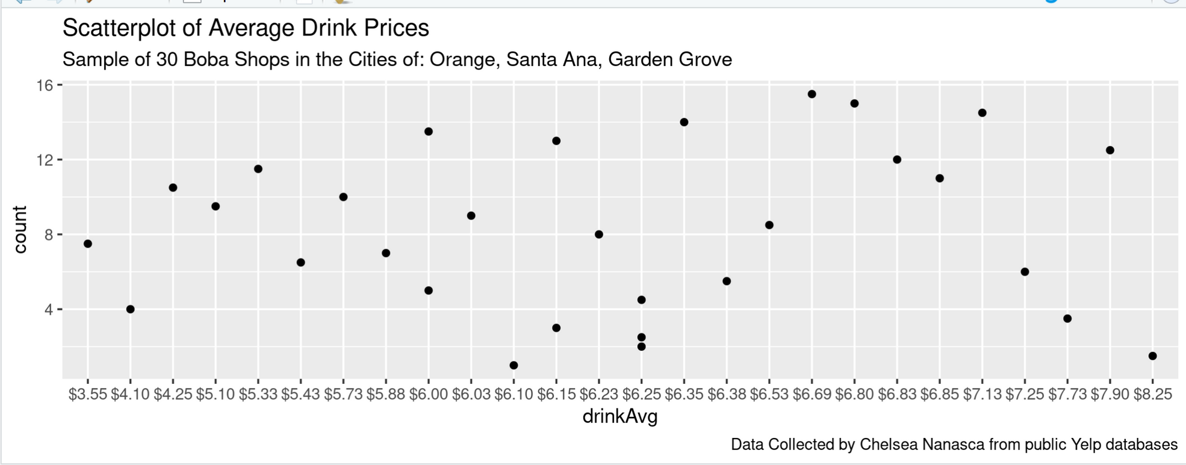
price range for average drinks
Evidence 4
This scatterplot was generated using R-studio, and displays the range of average drink prices.

Slide 62
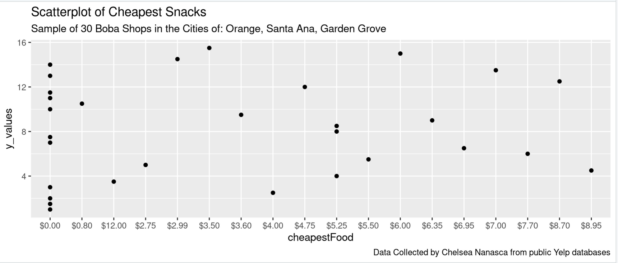
price range for cheapest snacks
Evidence 4
This scatterplot was generated using R-studio, and displays the range of cheapest foods.

Slide 63
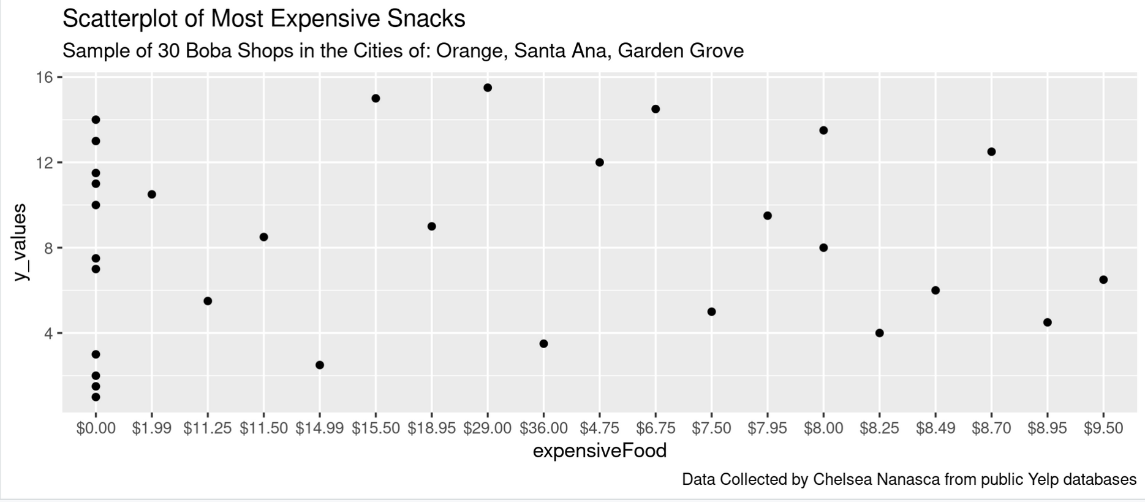
price range for expensive drinks
Evidence 4
This scatterplot was generated using R-studio, and displays the range of expensive foods.

Slide 64
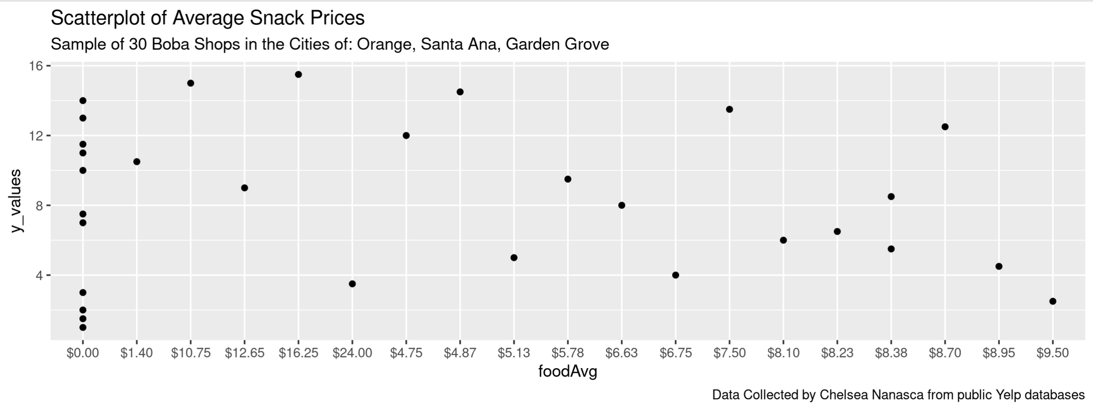
price range for average snacks
Evidence 4
This scatterplot was generated using R-studio, and displays the range of average food prices.

Slide 65
prices
Guiding Questions 2, Evidence 4
A majority of the cafes analyzed have generally lower price ranges for drinks.
Many boba cafes also offer food/snacks to pair with boba. This may bring additional revenue to the restaurant!
Have a Bachelor’s Degree

Slide 66
prices
Guiding Questions 2, Evidence 4
However: It is important to note that
11 of the restaurants in my dataset did NOT serve food. This is because many customers choose not to buy food and also because it adds to the overall cost.
Have a Bachelor’s Degree

Slide 67
Evidence
Five
What does it cost to rent in your assigned city?
Have a Bachelor’s Degree

Slide 68
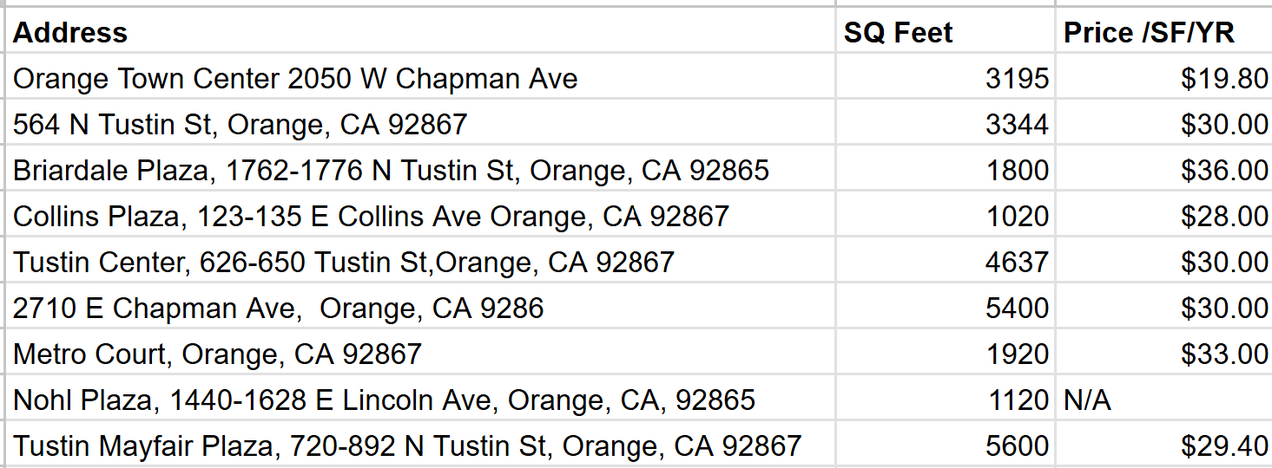
retail spaces in the city of Orange
Evidence 5
This table shows available retail space in the city of Orange, according to loopnet.

Slide 69
listings
Guiding Questions 2, Evidence 4
After observing the available listings, I thought that the listing in Briardale Plaza had been the most appropriate. This is because, it had the smallest amount of retail space, and had a good price. Furthermore this retail space is a good distance from nearby schools and has a lot of foot traffic.
Have a Bachelor’s Degree

Slide 70
Evidence
Six + Seven
What are the start-up costs and operational expenses? What are the total costs per year?
Have a Bachelor’s Degree

Slide 71
Necessary Equiptment for Boba Restaurant: Technology
Equiptment for Boba Shops:
Reach In Refridgerator: $1,949.00
Bubble Tea Sealer: $349.99
Bubble Tea Shaker: $999.00
Fructose Dispenser: $849.00
Stovetop: $1,042
Aluminum Stock Pot (2): $110.98
Spider strainer: $33.48
Tables and 6 Chairs (x3): $1557
Couches (x2): $1238
start up costs
in Orange
evidence 6
Info from: Webrestauraunt Store
Total: $8127.46

Slide 72
Necessary Equiptment for Boba Restaurant: Individual Drinks (bulk)
3.5 lb drink powder: $114.49
30 flavors: $3,434.70
Tapioca Pearls (6.6 lb/case): $64.99 per case, $194.97 for 3
Lychee Topping (7.28 lb): $84.49
Creamer Powder (2.64 lb): $19.49
1000 Rounded 24 oz cups: $218.99
Seals for Boba (3900): $47.49
1,600 Boba Straws: $65.99
start up costs
in Orange
evidence 6
Info from: Webrestauraunt Store
Total: $4066.12

Slide 73
Necessary Equiptment for Boba Restaurant: Individual Snacks (bulk)
6.6 lbs of Pork Gyoza Dumplings: $62.49
8 Case of 40 oz Tofu Dumplings: $102.99
200 Folded Take-Out Containers: $41.99
Canola Oil (35 lb): $40.49
start up costs
in Orange
evidence 6
Info from: Webrestauraunt Store
Total: $247.96

Slide 74
Cost of Labor
Average Hourly Pay for Boba Barista: $15.35
Yearly Pay for Boba Barista: $32,240
Assuming we hire six full time employees, it would be:
start up costs
in Orange
Guiding Questions 5
Total: $193,440
Info from: Zip Recruiter

Slide 75
Necessary Equiptment for Boba Restaurant: Individual Drinks
$5.35 profit per drink
Assuming 100 drinks are sold a day: $535 Dollars A Day
The Boba Shop will be open everyday except for weekends, meaning that it would be open 252 days a year.
This would be
yearly income
per drink
Evidence 8
Total: $134,820 for the first year

Slide 76
Necessary Equiptment for Boba Restaurant: Individual Drinks
$3.24 profit for pork gyoza
Assuming 80 orders are sold a day: $348.80 Dollars A Day
The Boba Shop will be open everyday except for weekends, meaning that it would be open 252 days a year.
This would be
yearly income
pork gyoza
Evidence 8
Total: $65,318.40 for the first year

Slide 77
Necessary Equiptment for Boba Restaurant: Individual Drinks
$4.36 profit for tofu gyoza
Assuming 80 orders are sold a day: $348.80 Dollars A Day
The Boba Shop will be open everyday except for weekends, meaning that it would be open 252 days a year.
This would be
yearly income
tofu gyoza
Evidence 8
Total: $87,897.60 for the first year

Slide 78
Step 6: Act

Slide 79
guiding questions 1
WHAT SHOULD YOUR INVESTOR CHARGE FOR THE 5 MOST POPULAR DRINKS? FOODS?
SHOULD THE INVESTOR RENT A STANDALONE SHOP, SHOPPING CENTER, OR MALL KIOSK?
drinks: $6.00, food: $5.45
While looking at rental spaces in the City of Orange, I found that renting a standalone shop was the best option. Mall kiosks do not provide enough space for a restaurant, and a shopping center requires additional charges to rent out. Not only that, but malls don’t have as many people day-to-day, and such it is better to have a standalone shop.
I found that these were the prices that provided the best profit margin for our investor, while also keeping it below average.
This ensures that the food will stay affordable for the surrounding campuses, encouraging a larger student body to visit.

Slide 80
guiding questions 2
SHOULD THE INVESTOR BUY AN EXISTING BUISINESS OR BUILD AND EQUIP HER OWN?
WHERE SHOULD THE INVESTOR PUT HER BOBA SHOP?
Briardale Plaza 1762-1776 N Tustin St
In this scenario, I suggest that the investor should build and equip her own boba buisiness. Though it may be difficult in the beginning, franchising prices are incredibly high for successful boba shops.
Equipping your own boba shop is more cost effective in this scenario.
This is a small strip mall in Orange, California that is near two high schools, Chapman University, and a main road.

Slide 81
guiding questions
HAS YOUR DATA BEEN PROPERLY FORMATTED?
HOW CAN YOUR TEAM USE DIGITAL MEDIA TO ATTRACT NEW CUSTOMERS?
FINAL CONCLUSION
Organizing a boba restaurant in the City of Orange could be a profitable venture, if we are to focus on advertising to students and young adults in the City of Orange.
My team could apply my buisiness insights into what type of foods, beverages, and also have a general estimate as to how much this buisiness could cost.
My team careould work especially within buisiness focused networks like Google Maps and Yelp to make sure that buisiness information is readily available online. We could also work with social media networks like Instagram, Facebook, and TikTok to share menu items!

Slide 82
elevator pitch
Do you love sipping boba?
Concepts for up-and-coming Boba Buisiness venture in Orange, California
Analyzed 30 Boba Buisinesses: Orange, Garden Grove, Santa Ana
Google Sheets → R Data Base used for Analysis
Analysis of average boba/food price ranges
Details on Profit Margins, Startup Costs, Yearly Income
Map of Nearby Boba Buisinesses
5 Most Popular Drinks to keep your buisiness trendy
Have a Bachelor’s Degree

Slide 83
thanks , keep drinking
boba
PLS HIRE ME

Slide 84
WORKS CITED:
Works Cited
works cited
GOOGLE SHEETS DATA:
Google Sheet: Boba_Shops
COMPLETE CHANGELOG:
Hyperlinks to all of my Works Cited
Documentation: Changelog
NOTES:
Notes I took

